Slide 1

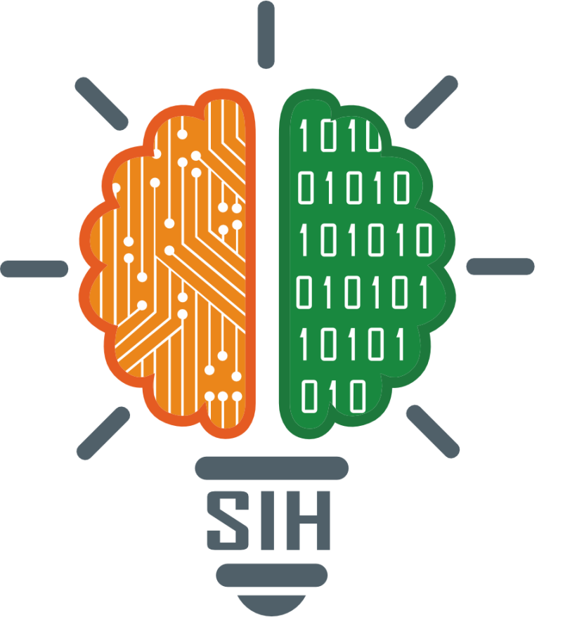

SMART INDIA HACKATHON 2025
TITLE PAGE
Problem Statement ID – SIH25048
Problem Statement Title-
Gamified Learning Platform for Rural Education
Theme- Smart Education
PS Category- Software
Team ID-
Team Name- InspyrX
Authority- Govt. of Odisha

Slide 2
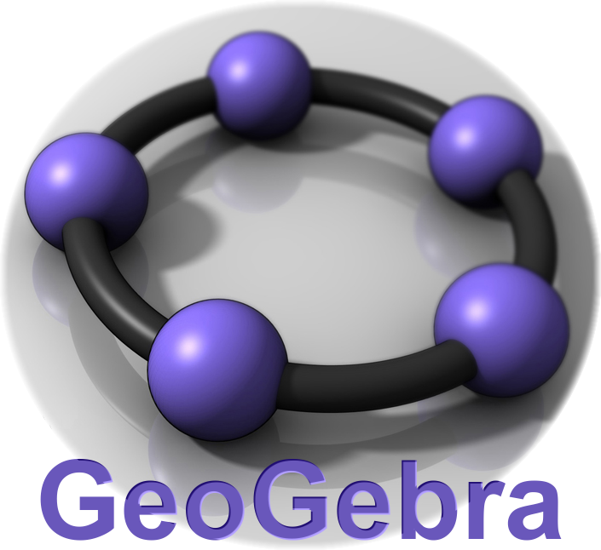


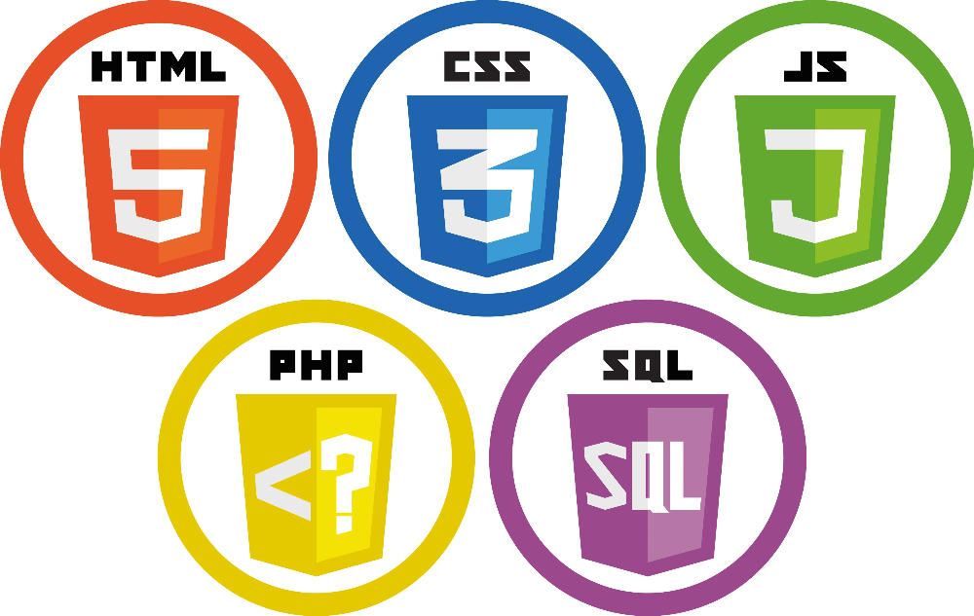
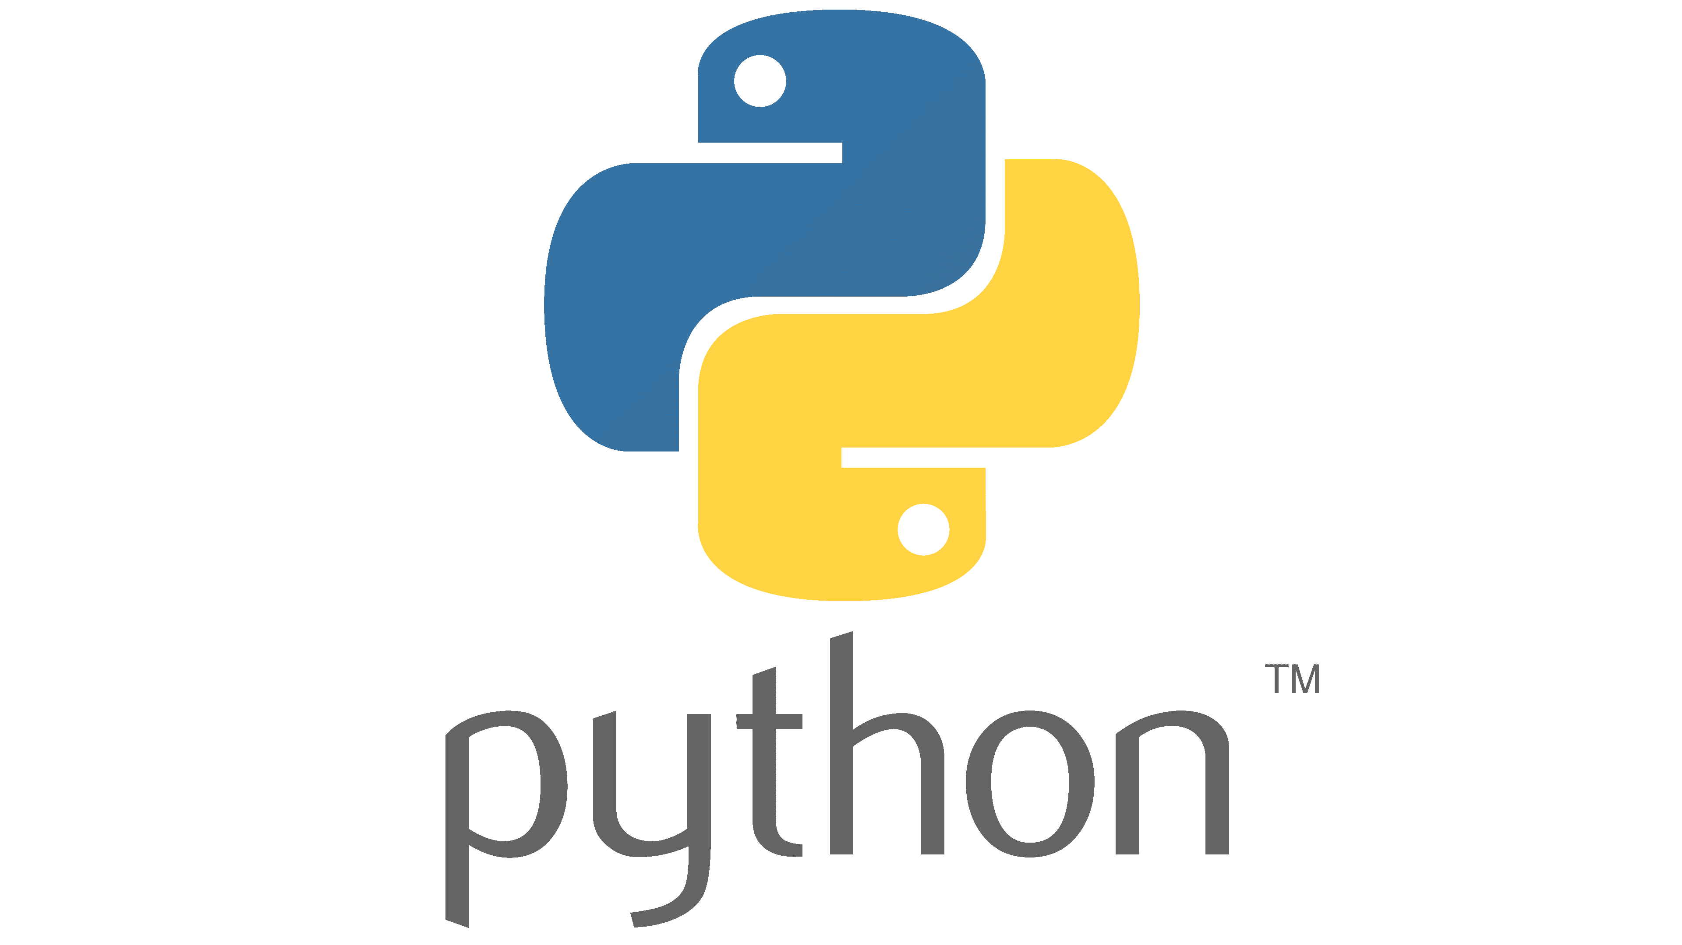
IDEA TITLE
InspyrX – The Gamified Learning Platform
Unified web-based platform- Central hub for interactive learning
One-stop solution
Reduced friction & technical barriers
Holistic, hands-on learning
Streamlit frontend
Cross-device accessibility
Lightweight application
Notes:
Technologies Used:
Frontend & Core Framework: Streamlit (Python)
Interactive Components: HTML, CSS, JavaScript
Educational Tools: GeoGebra (via JavaScript Applet), Scratch
AI Integration: ChatGPT API
Additional Frameworks: Bootstrap or Tailwind CSS (for styling)
We propose a unified, web-based platform that integrates multiple educational tools and content into a single, intuitive interface. Our solution provides a central hub for students to access interactive learning experiences without the need for multiple applications or costly software.
Our platform's innovation lies in its seamless integration of diverse learning tools—from a geometry applet (GeoGebra) to a visually programmed environment (Scratch) and —all within a single, lightweight application.
This "one-stop-shop" approach reduces friction, lowers the technical barrier for users, and encourages a holistic, hands-on learning experience. The use of a Streamlit frontend makes the app accessible on a wide range of devices, including low-powered computers.

Slide 3
TECHNICAL APPROACH
Agile, iterative process
Rapid prototyping
Proof-of-concept prototype
Streamlit-based development
Core functionality integration
User experience testing
User feedback-driven improvements
Idea validation
Modular architecture
Faster development & debugging
Working prototype
Concept feasibility proof
Notes:
Our approach follows an agile, iterative process focused on rapid prototyping and user feedback. We began with a proof-of-concept prototype, building a working version of the application using Streamlit to quickly integrate the core functionalities. This allowed us to immediately test the user experience and validate our core idea. The modular architecture of the project enables a faster development cycle and easier debugging. The current working prototype is the result of this approach, proving the feasibility of our concept.

Slide 4


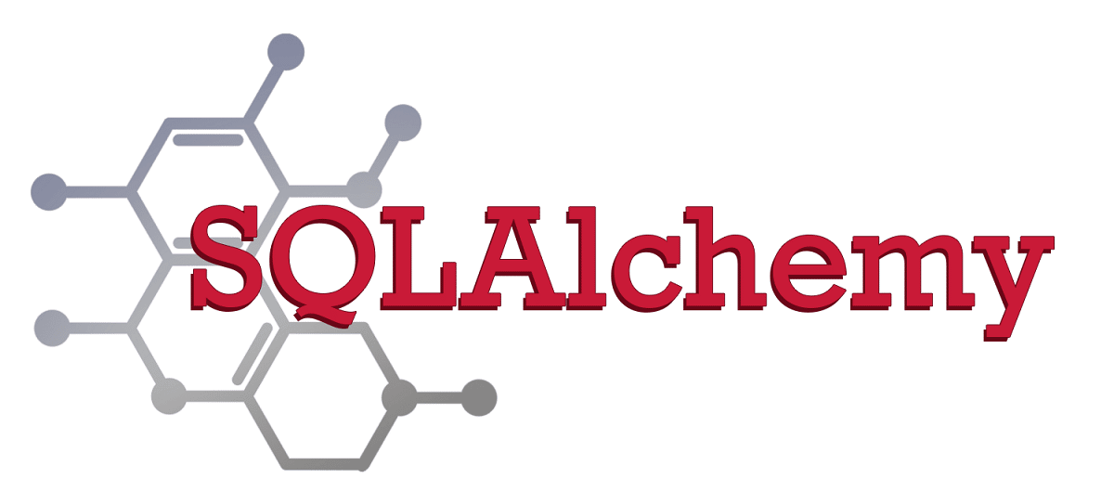
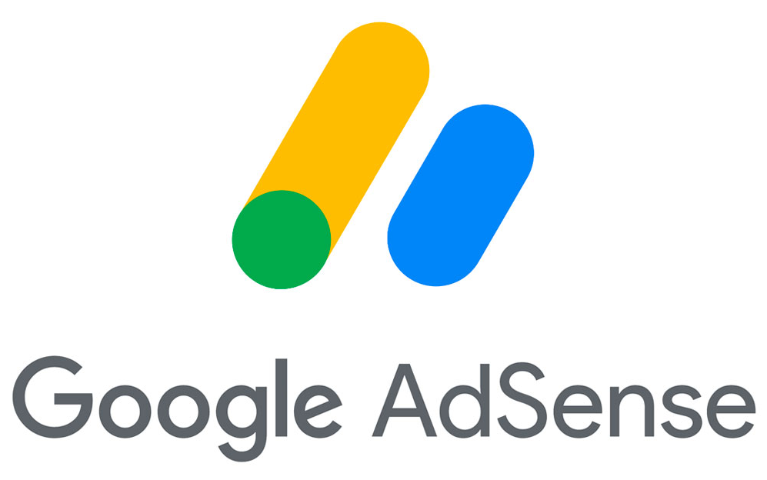


FEASIBILITY AND VIABILITY
Challenge
Persistency
Scalability
Strategies for
Overcoming Challenges:
Notes:
Feasibility:
Our solution is highly feasible, built on the principle that education must be free and accessible. By using open-source tools and a no-cost platform like Streamlit, we eliminate financial barriers for both students and the team. The absence of a login system or data storage addresses privacy concerns and prevents data leaks, making the platform safe and trustworthy. Revenue can be generated through a non-intrusive model, such as Google Adsense, once the platform gains traction.
Challenges:
Persistence: Streamlit is designed for prototyping and lacks native state persistence. Data, such as chat history or user creations, is lost when the app is refreshed.
Scalability: The current local-first approach is not scalable for a large user base without significant infrastructure investment.
Strategies for Overcoming Challenges:
To address the persistence and scalability challenges, we plan to transition to a more robust, full-stack framework. We will migrate to a versatile framework like Flask or React.js. This will allow us to implement user authentication, database integration (e.g., Firebase, Firestore), and persistent storage, turning the prototype into a fully functional, scalable web application.

Slide 5


IMPACT AND BENEFITS
Social:
Democratizes access to high-quality educational tools
Economic:
Reduces the financial burden on students and parents who would otherwise need to purchase expensive educational software.
Educational:
Fosters hands-on, creative learning by making complex tools simple and accessible.
Environmental:
Reduces the need for physical textbooks and materials
Bridging the digital divide between urban and rural students.
Promoting a paperless learning environment.
Target Audience:
Benefits of the Solution:
Notes:
Target Audience:
Our solution is designed for school and college students and their parents. By providing an easy-to-use, integrated platform, we can empower students to take control of their learning outside of the classroom.
Benefits of the Solution:
Social: Democratizes access to high-quality educational tools, bridging the digital divide between urban and rural students.
Economic: Reduces the financial burden on students and parents who would otherwise need to purchase expensive educational software.
Educational: Fosters hands-on, creative learning by making complex tools simple and accessible.
Environmental: Reduces the need for physical textbooks and materials, promoting a paperless learning environment.

Slide 6


RESEARCH AND REFERENCES
Our prototype is ready at: inspyrx.streamlit.app
Additional Features
Browser Extensions:
Screen Recorder
AI Powered Voice Assistant
Notes:
Our work is inspired by and builds upon the foundations of existing open-source and educational tools & can be extended to an online education app like Coursera.
Our prototype is ready at: inspyrx.streamlit.app
We have also researched the official documentation and community resources for Streamlit, GeoGebra, Scratch, and the various APIs we have utilized.
Additional Features
Browser Extensions:
We will also provide companion browser extensions that can be installed and run locally with the app. These extensions will add powerful features such as a screen recorder and a voice assistant to enhance the learning experience.

